Slide 1

Bakery Sales Analysis Project
Team A

Slide 2

Agenda
Data Cleaning and Preprocessing
Analysis Questions Phase
Dashboard Phase
Final Presentation

Slide 3
Data visualization is powerful. Still, data storytelling is the thing driving decision-makers.
Monika Piekarska
data visualization expert

Slide 4
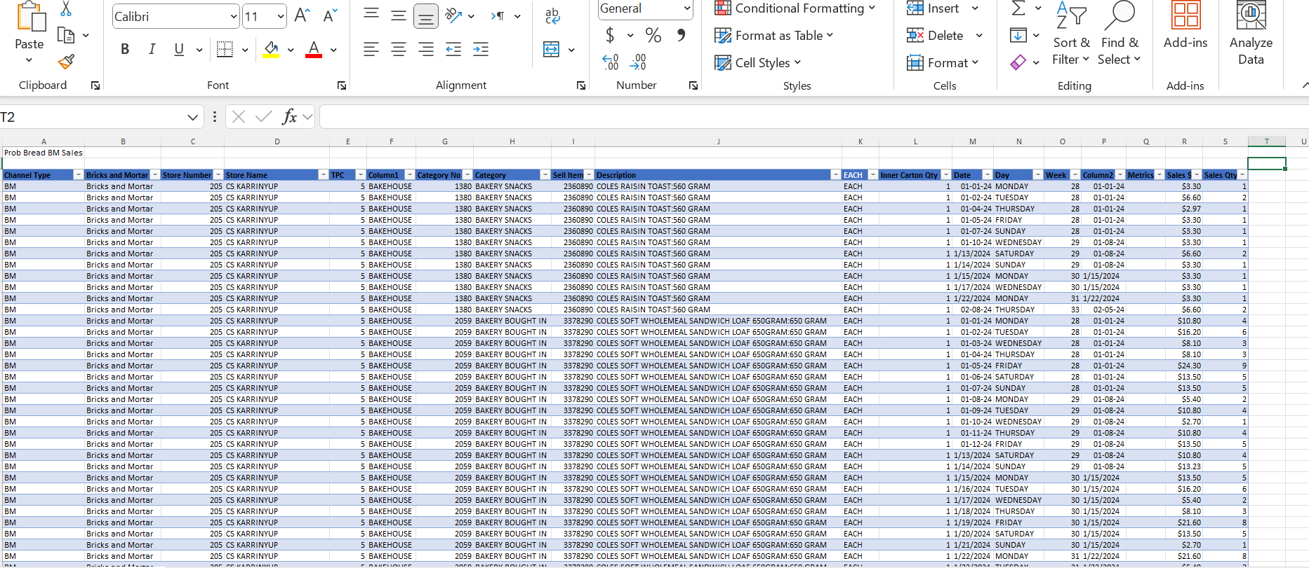
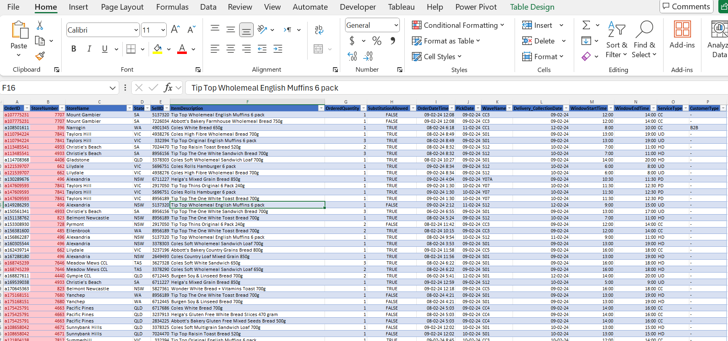
Data
The data illustrates the flow and movement of orders / items sold within a bakery shop.
The data represented in 2 separate excel sheets:
One excel for past orders.
The other excel for planned future orders.

Slide 5

Data Cleaning and Preprocessing
Data upload, extract, then transform in power query editor then Close & Apply
Some columns required a change in data type, date format, add conditional columns, check null values, merge as new.

Slide 6
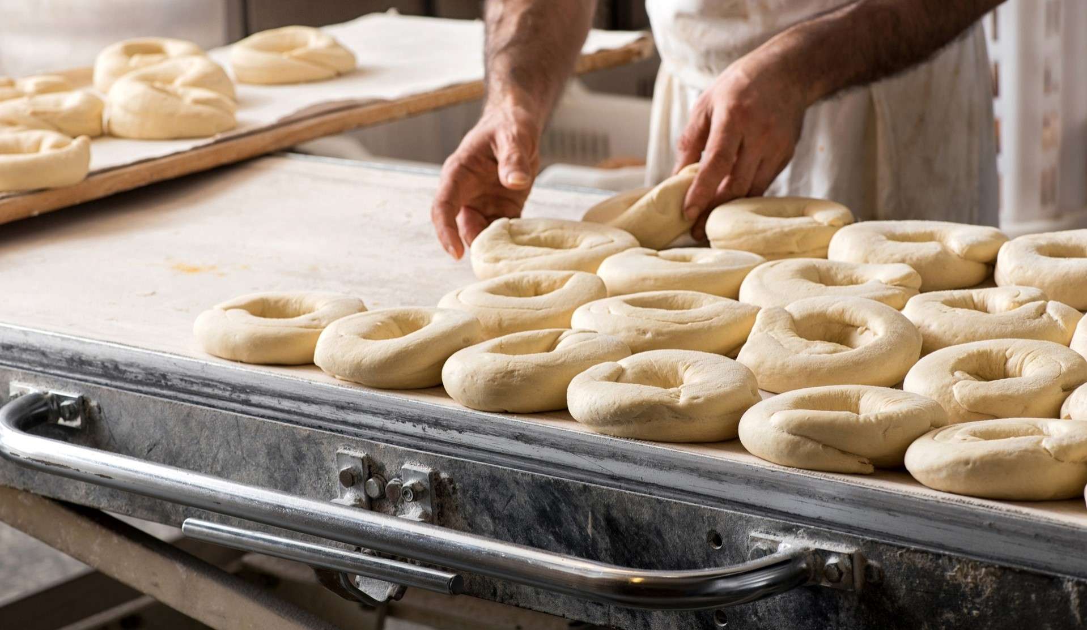
Analysis question phase
Total value & quantities sold in the past
Total quantities planned to be sold in the future
Top selling Stores
Top selling items
Top selling States
Daily & monthly trend of items sold?
# of orders by service type
Planned future orders by delivery date
Lead time to prepare future orders
Stores consistency selling

Slide 7
Team
Name Title
Name Title
Name Title
Name Title

Slide 8
THANK YOU

